Slide 1
ACR Advocacy 101:
How Educators, Scientists, & Trainees Can Affect Change
Grand Rounds
Rheumatology Divisions in the United States

Slide 2
Disclosures

Slide 3
Agenda
ACR Advocacy overview
Washington Update
What does ACR do for our profession?
YOU Can Make a Difference – today!

Slide 4
Agenda
ACR Advocacy overview
Washington Update
What does ACR do for our profession?
YOU Can Make a Difference – today!

Slide 5
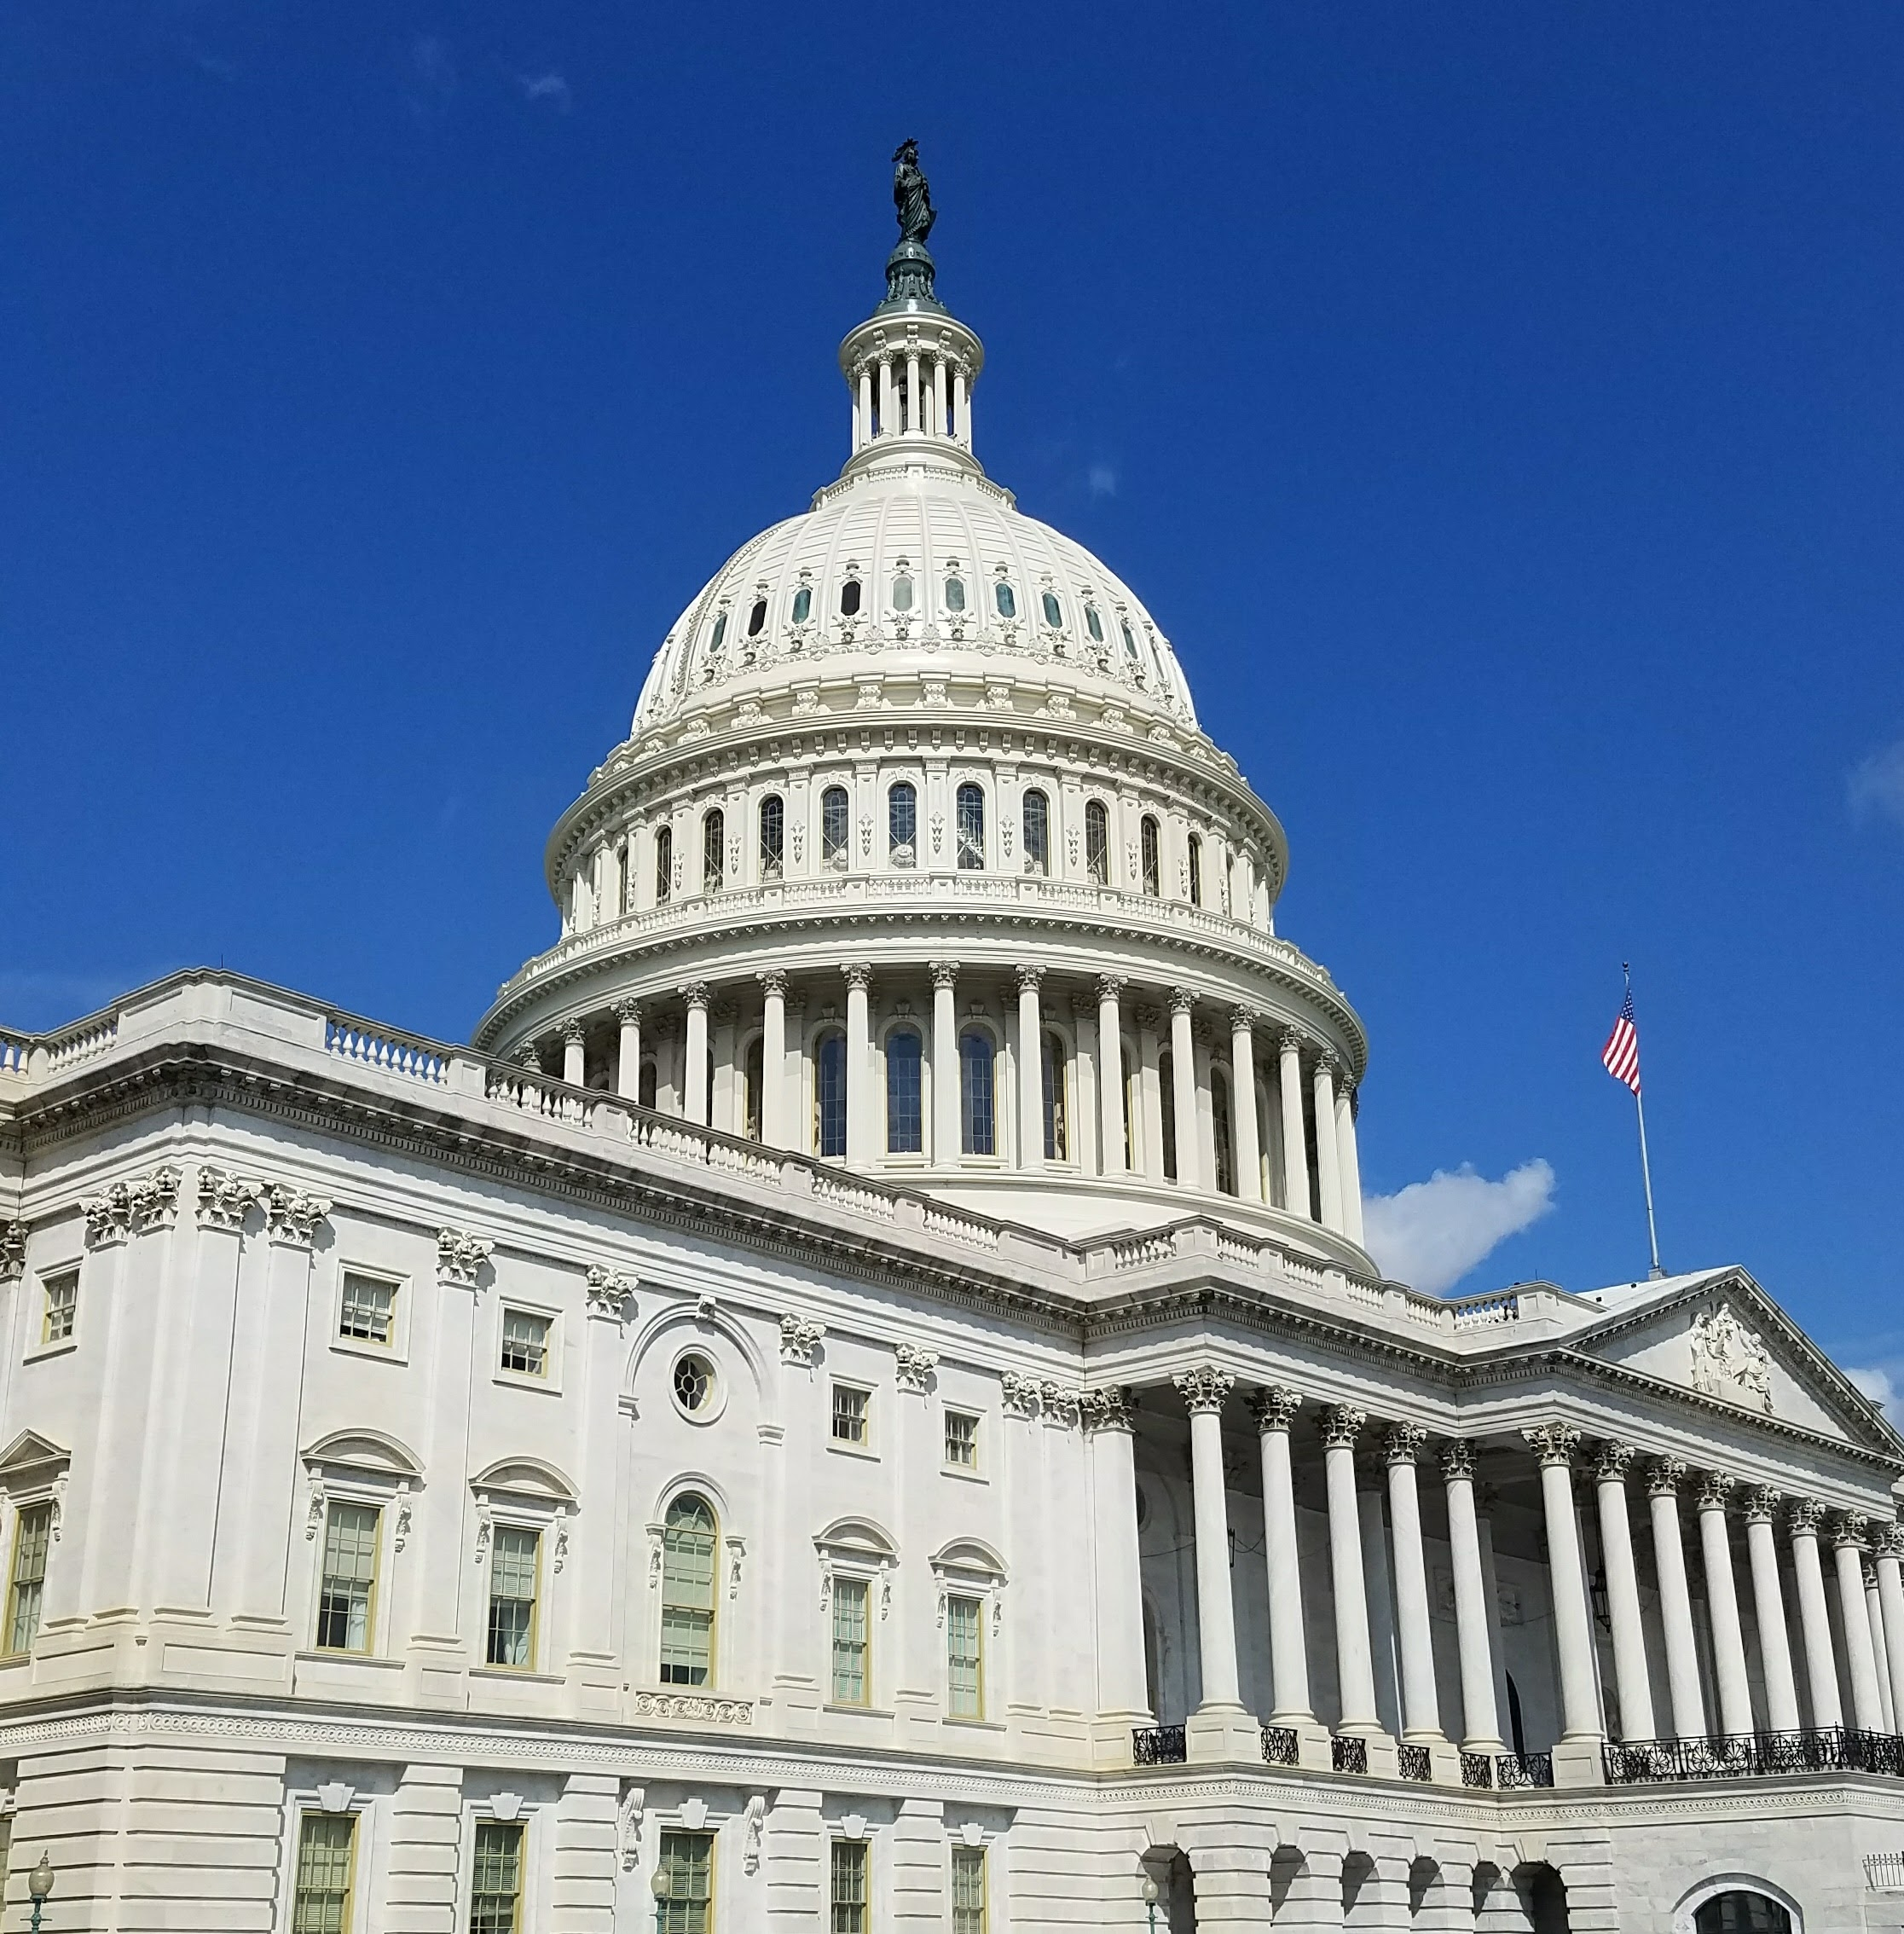
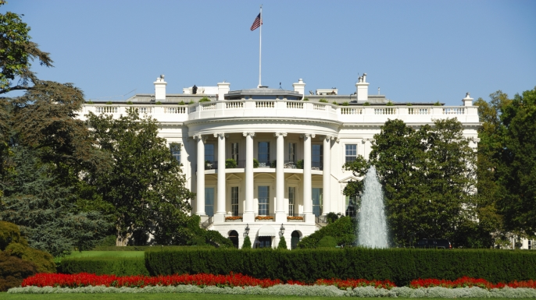
US Health “System”
Notes:
Let’s start with the basics
US federal government includes 3 branches. Two of them: Legislative branch (left) and Executive branch (right) are involved in health care and open to public input.

Slide 6
US Health “System”
Notes:
The Congress holds the power of the purse and appropriates money to health agencies, agencies. It also writes laws which the President can sign or veto.

Slide 7
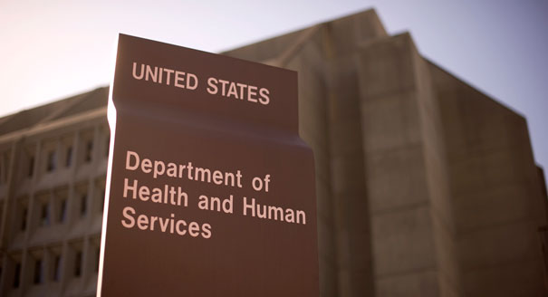
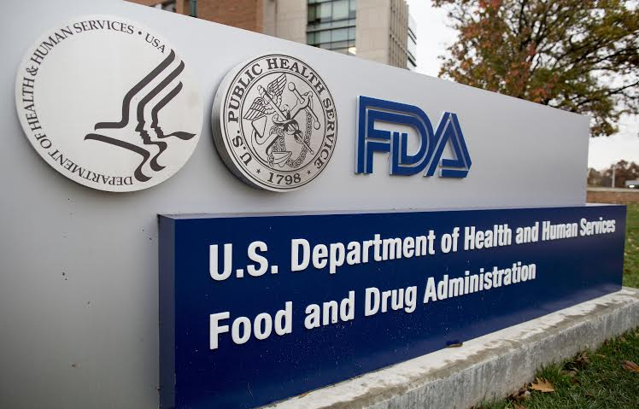
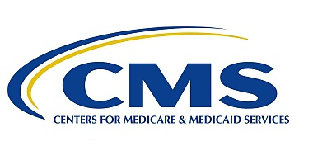
US Health “System”
Notes:
The executive branch enforces the laws by staffing agencies of bureaucrats and regulators, and spends the money Congress appropriates.’

Slide 8
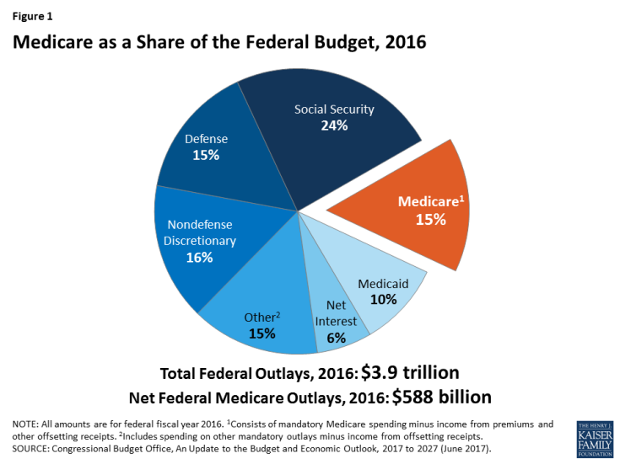
Cubanski and Neuman, Kaiser Fam Foundation 2017
Notes:
Speaking of Money. This is the 2016 US federal budget of $3.9 Trillion.
Orange call-out wedge is Medicare, representing $588 billion or 15% of the budget and Medicaid below it another 10%. A hospital, B outpatient, C MA, D Rx’s.
These programs together total 25% of the US federal govt spending. They are a similar percentage of health spending overall together with commercial insurance.
Needless to say, there are a lot of individuals and organizations telling the gov’t about what to do with that large slice of the pie.

Slide 9
FSMB.org 2016, and Battafarano et al 2018
Notes:
Meanwhile, rheumatologists represent a small sliver of US doctors. We are approximately 6000 (0.6%) of about 1 million physicians in the US
People sitting in the back can be forgiven if they can’t see the slice representing rheumatologists!

Slide 10
Notes:
Like a little fish in a big pond, we dream big.

Slide 11
“Never doubt that a small group of thoughtful, committed citizens can change the world; indeed, it's the only thing that ever has.”
Margaret Mead

Slide 12
Notes:
Founded in 1934 as the American Rheumatism Association, and since 1998 known as the ACR, this organization has grown to comprise over 100 staff – and a top place to work 3 years running (as of Feb 2019) per the Atlanta Journal Constitution

Slide 13
Your ACR Practice and Advocacy Team
Rachel Myslinski, MBA – VP, Practice, Advocacy & Quality
Adam Cooper, MS – Sr. Director, Government Affairs
Kayla Amodeo, PhD – Director, Regulatory Affairs
Joseph Cantrell, JD – Sr. Manager, State Affairs
Lennie Shewmaker, JD – Sr. Manager, Federal Affairs
Antanya Chung, CPC, CPC-I, CRHC, CCP – Director, Practice Management
Meredith Strozier – Director, Practice Advocacy
Janell Martin – Director, Registry Operations
Melesia Tillman – Specialist, Coding and Reimbursement
Tracy Johansson – Director, Registry Analytics
Norlita Brown – Specialist, Registries & HIT
Notes:
11 of the ACR staff work tirelessly on your behalf to support rheumatologists and rheumatology professionals advocating across all the issues our profession faces.

Slide 14
Government Affairs Committee 2019 Roster
Howie Blumstein, MD
Courtney Crayne MD
Ethan Craig MD
Bonnie Libman MD
Christina Downey, MD
Jessica Farrell, Pharm.D
Robert Jenkins, MD, PhD
Ryan Jessee, MD
Bharat Kumar, MD
Brian Loggins, BS, BBA, MBA
Victoria Menzies, PhD, RN
Christopher Morris, MD
Lisa Robbins, RN, BSN, CPNP
Tamar Rubenstein, MD
Roy Sampson, MD
Blair Solow, MD
Kristi Kuhn, MD, PhD
Kelly Weselman, MD
Angus Worthing, MD (Chair)
Notes:
Speaking of hard-working: these volunteers across the country on the GAC include 1 fellow (Crayne) and currently 3 recent graduates (Drs. Downey, Kumar, Craig), and 7 academicians: Craig, Libman, Downey, Kumar, Rubenstein, Kuhn, Jessee.
All rheumatologists are encouraged you to apply for a volunteer position – a 3-year term (1-year for fellows)

Slide 15
ACR’s Overarching Advocacy Pillars:
Patient Access to Rheumatology Care
Patient Access to Treatments
Research, Training & Workforce
Notes:
Generally, rheumatology advocacy addresses 3 main issues. Access to care & treatments, and strengthening our research, training and workforce.

Slide 16
Select Rheumatology-related Policy Issues
Workforce/GME/Training
Prior Authorization
Step therapy
Biosimilars: notification, naming, education
MACRA (MIPS/APM)
PBM reform
Drug price reforms
Research funding
Increase value of E/M
Complex infusion codes
Pediatric Access
Part B Sequester
Restore DXA
Protect MSUS
Access to Care
Network Adequacy
Tier 4 coinsurance
Notes:
Rheumatologists have a large number of issues affecting us and our patients. I’ll do a deep dive on a few examples of what ACR is doing right now on a few of these.
But first: as a small fish in a big pond of US health care, and a large list of critical issues:
How we leverage our voice?

Slide 17
Leveraging ACR’s voice

Slide 18
Leveraging ACR’s voice
Workforce/GME/Training
Prior Authorization
Step therapy
Biosimilars: notification, naming, education
MACRA (MIPS/APM)
PBM reform
Drug price reforms
Workforce gap
Research funding
Increase value of E/M
Complex infusion codes
Pediatric Access
Part B Sequester
Restore DXA
Protect MSUS
Access to Care
Network Adequacy
Tier 4 coinsurance

Slide 19
Coalitions
Grassroots emails
Op-Eds, press reports
Capitol Hill Fly-ins, A101
RheumPAC
AMA
Leveraging ACR’s voice
Workforce/GME/Training
Prior Authorization
Step therapy
Biosimilars: notification, naming, education
MACRA (MIPS/APM)
PBM reform
Drug price reforms
Workforce gap
Research funding
Increase value of E/M
Complex infusion codes
Pediatric Access
Part B Sequester
Restore DXA
Protect MSUS
Access to Care
Network Adequacy
Tier 4 coinsurance
Notes:
How we leverage our voice – given many issues, small society/resources. INCLUDE A101 in fly in –educating next generation of rheumatologists to advocate for our profession.
Also, our strategy is issue-based, so we support issues or parts of legislation, and stick to what matters to rheumatologists, to avoid burning bridges politically.
There are many ways, large and small, to get involved

Slide 20
Agenda
ACR Advocacy overview
Washington Update
What does ACR do for our profession?
YOU Can Make a Difference – today!

Slide 21
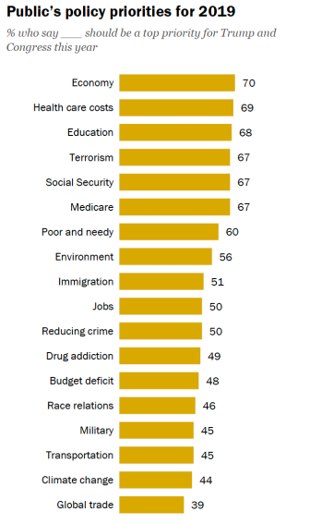
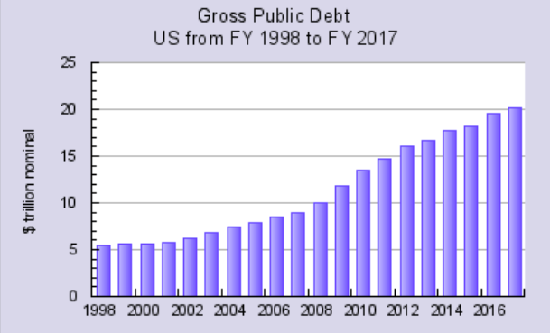
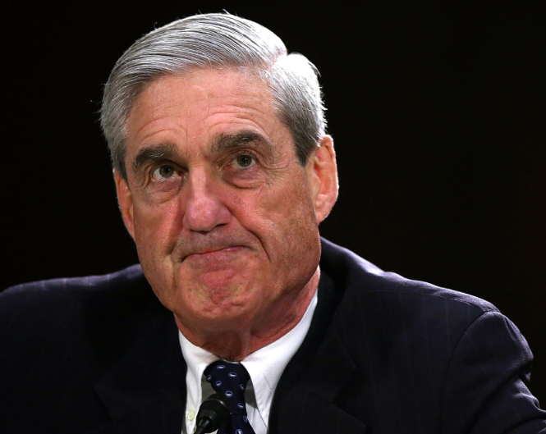
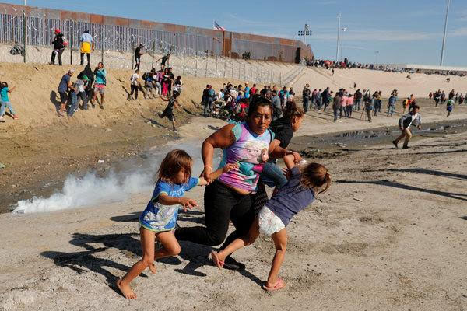
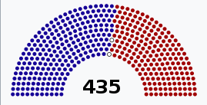
Notes:
So what are some of the issues the American people are listing as grievances these days?
#1 worry in America per a recent Pew poll is the Economy, as usual, and #2 right now is rising health care costs.
Stock market has been strong, but volatile, and we have large $1Trillion budget deficits and national debt of 22T (rising $2M/minute)
There’s a crisis on the Southern border
9 months into 116th Congress and 2.5 yrs into Trump administration.
Now that Robert Mueller and his team finished their report the investigation moves from the Justice Dept to Congress, along with other oversight of the executive branch and possible impeachment investigation. This increases an already Hyper-partisan landscape.
There is bipartisan support for reducing the prices of drugs

Slide 22
Possible areas of bipartisan reform
Drug pricing proposals
Capping out of pocket costs in Medicare Part D
Lowering drug prices by negotiation or foreign reference pricing
Improving transparency of pharmacy benefit managers
Notes:
Again, partisanship. Will anything get accomplished with all the partisanship around the Mueller report, the border wall, and the upcoming 2020 elections?
Americans pay increasing amounts for their medical bills and specifically drug costs.
This puts more pressure on the President and Congress to do something before 2020.

Slide 23
Agenda
ACR Advocacy overview
Washington Update
What does ACR do for our profession?
YOU Can Make a Difference – today!

Slide 24
ACR LEAD
Recent ACR “Wins”
E/M code cuts reversed! (Proposed)
No MIPS adjustments on Medicare drug reimbursement
MSK US reimbursement cuts dampened in Medicare
MA step therapy “Grandfathering” regs more favorable
Cancelled UHC’s downcoding policy for biologic administr’n
PBM “gag clauses” prohibited
No annual cap on PT/OT in Medicare
DACA protected: could provide care for 100K Americans

Slide 25
Recent ACR Insurance Subcommittee “Wins”
Cancelled policy downcoding administration of biologic drugs (UHC)
Delayed policy cutting reimbursement for E/M services when billed with modifier 25 (UHC)
Delayed policy to discontinue reimbursement for consultation codes
Fixed system error causing inappropriate denials for steroid injections (Aetna)
Notify ACR of coverage problems: Advocacy@rheumatology.org, or fill out a health plan complaint form (search “ACR insurance”)

Slide 26
Biomedical Research
ACR initiative: earmark $20 Million/year dedicated to arthritis research at Department of Defense
Also: boosting NIH and CDC

Slide 27
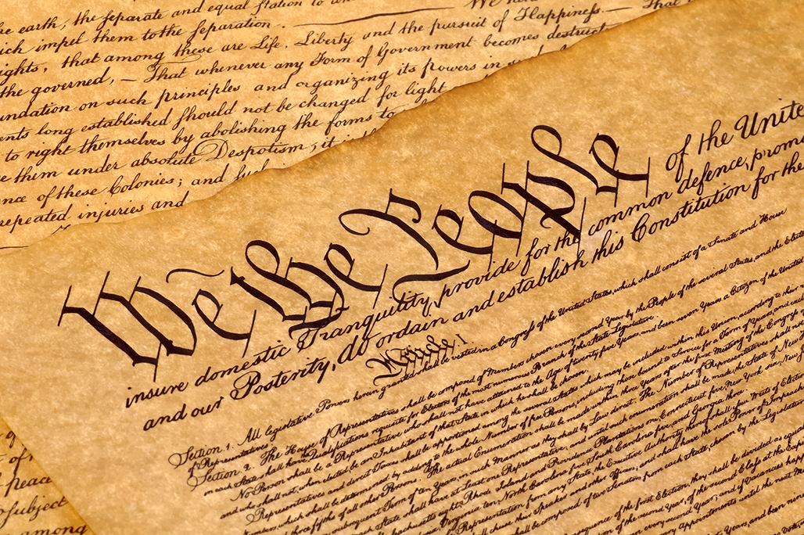
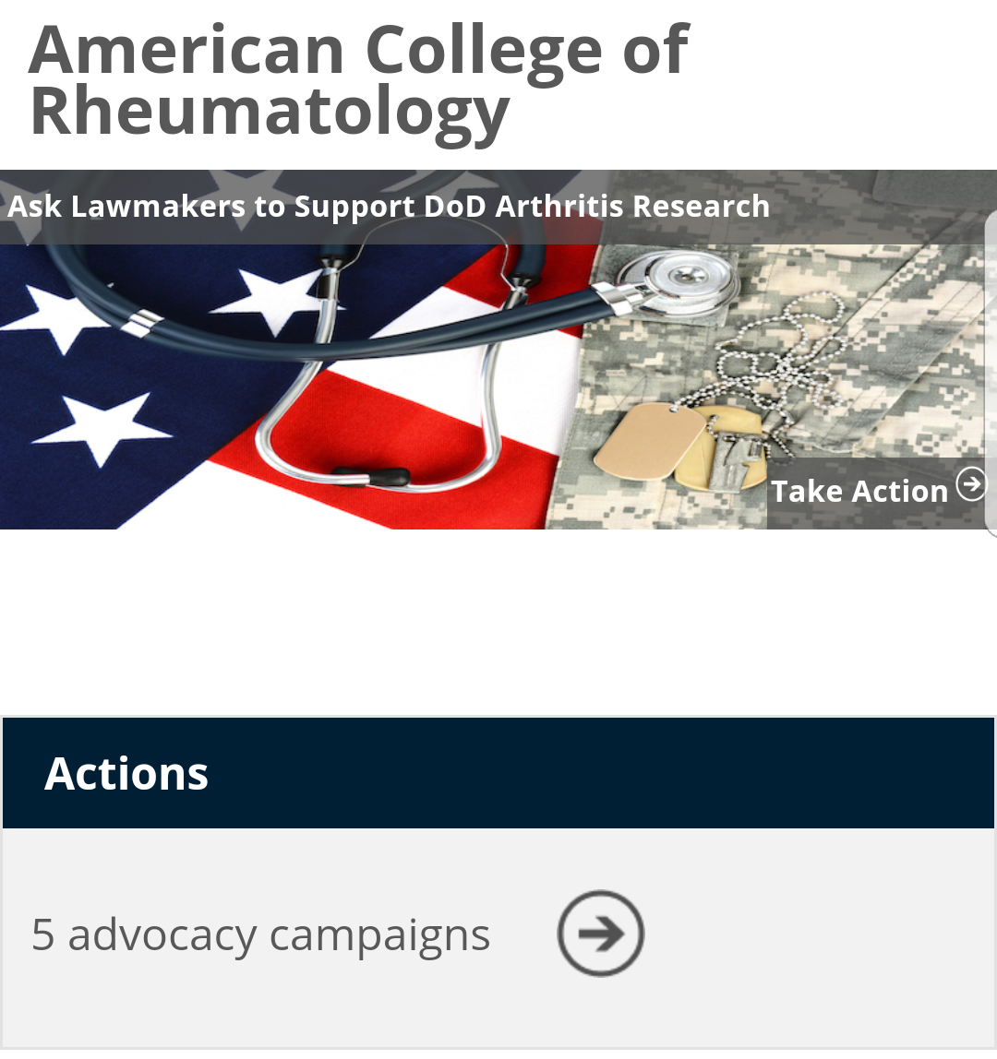
First Amendment Exercise
Search “Rheum Legislative Action Center”
Send pre-written letters
Find legislators
Find legislation
Sign up for email alerts
Notes:
What can you do if you hear about an issue in the paper, or on Twitter, or when your prescription gets blocked by insurance?
Go to the ACR legislative action center and quickly email your members of Congress – I invite you to do this during this lecture!
Current letters at the website: DOD research “ask”, Osteoporosis screening (check for updates) and a blank template for you to write about your issue/concern
When you see this picture of the constitution in this slide deck, think about the first amendment right to petition government for a redress of grievances, and email Congress!

Slide 28
DXA Reimbursement
Increasing Access to Osteoporosis Testing Act
Bipartisan bicameral support
Would raise Medicare reimbursement to $98 for DXA
Please email Congress now!

Slide 29
Prior Auth Reform
Adds electronic option for Medicare Advantage plans
Improves transparency, timeliness, use of guidelines
Reduces use of PA in cases with high approval %
Please email Congress now!
Notes:
Last year I asked you to stay tuned for legislation reforming PA and step therapy at the federal level and I’m happy to say that they’ve been introduced!

Slide 30
Workforce
Hayley McCloud
Sr. Manager of State Affairs hmccloud@rheumatology.org

Slide 31
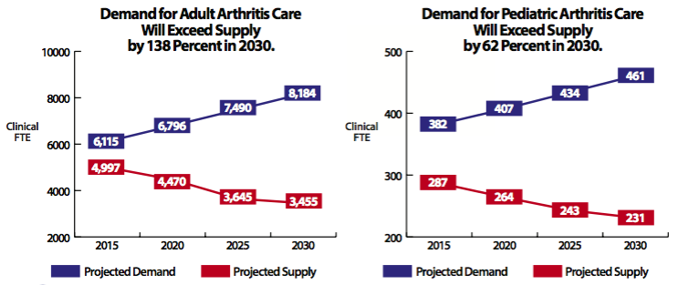
Demand for adult arthritis care will exceed supply by 138% in 2030 and rheumatologists are concentrated in cities.

Slide 32
Workforce – ACR Supports:
Additional resident positions
Funding for rheumatology fellowship positions
Ways to attract pediatricians to rheumatology
Loan repayment for rheums in underserved areas
EMPOWER Act for peds rheum
State initiatives (Georgia, others?)
“DACA” (Deferred Action for Childhood Arrivals)
Could provide care for 100,000 US patients, per AMA
Hayley McCloud
Sr. Manager of State Affairs hmccloud@rheumatology.org

Slide 33
Workforce – ACR Supports:
Additional resident positions
Funding for rheumatology fellowship positions
Ways to attract pediatricians to rheumatology
Loan repayment for rheums in underserved areas
EMPOWER Act for peds rheum EMAIL NOW
State initiatives (Georgia, others?)
“DACA” (Deferred Action for Childhood Arrivals)
Could provide care for 100,000 US patients, per AMA
Hayley McCloud
Sr. Manager of State Affairs hmccloud@rheumatology.org

Slide 34
Health Reform in the Era of Obamacare
“Repeal and Replace” bills failed in 115th Congress
Mandate penalty to $0
Deregulation
The ACR Supports:
Sufficient, affordable continuous coverage
Affordable premiums, deductibles, cost-sharing
Protecting essential health benefits
Notes:
In the 115th Congress, R&R failed but mandate penalty went to $0
Deregulation expanded insurance plans that lack patient protections & coverage for rheumatic diseases
In letters, meetings with Medicare and HHS officials, the ACR supports protecting patient access to…

Slide 35
PBM Transparency
The issues:
Incentives: Rebates push prices up, dictate formularies
Consolidation: 3 companies have 70% of prescriptions
Secrecy
May prevent biosimilars cost-savings
Goals:
Make PBMs more transparent
Improve access to treatment
Wins:
Senate legislation would eliminate rebates in Medicare
Pharmacist “gag rule” banned in 2018
Arkansas 1st state to regulate PBMs
Virginia transparency bill passed
Notes:
ACR co-convened ATAP with CSRO & others to shed light on the issues of PBMs.
PBMs write drug formularies (step therapy) with preference going to the drug with the largest rebate, not the highest quality or lowest price.
In order to afford a higher rebate, manufacturers might be incentivized to raise prices. As if they needed more incentive.

Slide 36
Step Therapy Reform
Create national exception process if step protocol drug expected to fail, cause A/E or disability
HR 2077 by Drs Wenstrup and Ruiz (Podiatrist and Physician)
Senate companion bill expected fall 2019
Email Congress now!
Notes:
(email alert coming soon as of Feb 2019)

Slide 37
Biosimilars: ACR Supports
Rheumatologists using biosimilars
FDA draft pathway for interchangeable biosimilars
clear FDA labels
meaningful, individual name suffixes
education about biosimilars
Notes:
FDA pathway: rigorous analysis of immunogenicity after 3 switches from orginiator→biosim→originator→biosimilar
Clear labels: asking to clarify whether or not a drug is biosimilar and interchangeable; also a link to clinical data for the biosimilar

Slide 38
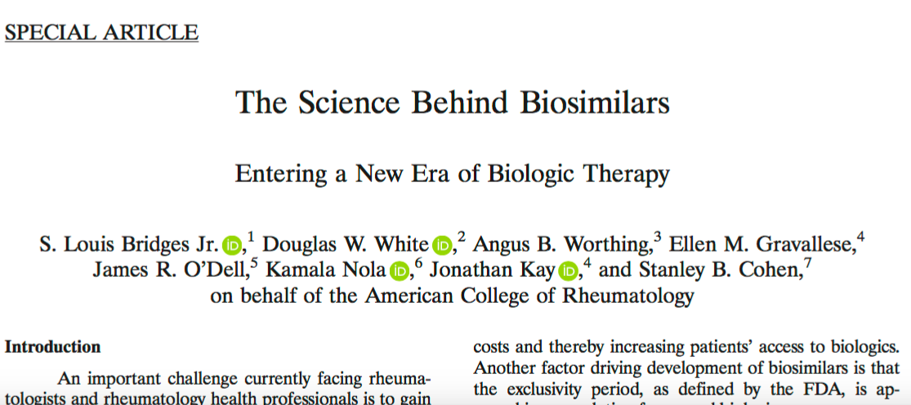
A&R March, 2018
Notes:
ACR white paper on biosimilars: it’s open access. Please read & share!
Supports rheumatologists using biosimilars
PBM-pharma relationships may prevent savings for patients and the system

Slide 39
MACRA For Fellows and Divisions
Notes:
Raise your hand if you think your division or institution will qualify for the APM track (an ACO, PCMH, etc)

Slide 40
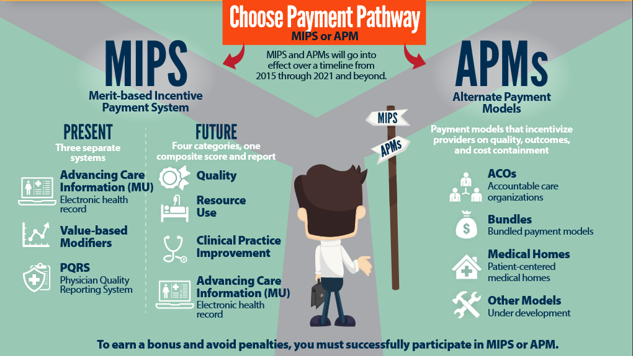
MACRA: Medicare’s 2 Pathways. Since 2017
Notes:
MACRA is Medicare’s way of modifying the fee for service system since 2017, by changing FFS to “MIPS” which adjusts reimbursement based on a score for each physician or practice that is based on quality, resource use (now called Cost), Clinical Practice Improvement, and ACI (now called Promoting Interoperability).
To avoid potentially negative adjustments, physicians can join an APM.

Slide 41
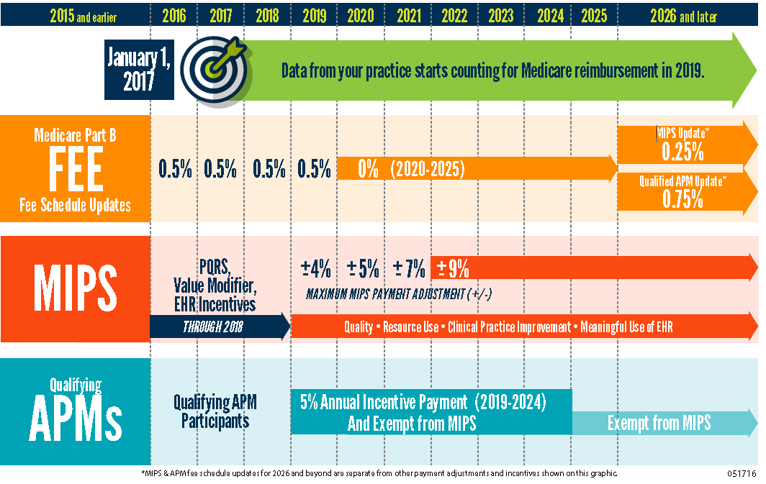
0.25%
_____
Notes:
Compared to MIPS, with adjustments based on performance of +/-4% in 2019 based on 2017 performance, APM track offers 5% bonus 2019-2024
Consider what a 9% cut means to a hypothetical entity with 70% overhead, in which a doctor takes home 30% of reimbursement. Say, 30 cents on the dollar. Reducing the total reimbursement 9%, or 9 cents, brings hypothetical reimbursement to 91 cents, and with overhead stable at 70 cents, doctor takes home only 21 cents compared to 30 cents = 30% cut.
Then, there will be a difference in yearly fee schedule updates for the 2 tracks starting in 2026

Slide 42
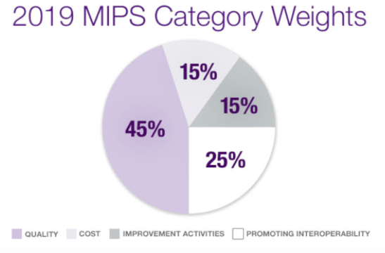
Notes:
For those in MIPS: Points from 4 categories add to one composite score. You avoid cuts with a score at or above the performance threshold (3 points in 2017, 15 in 2018, 30 in 2019), and get extra bonus above an exceptional performance threshold.

Slide 43
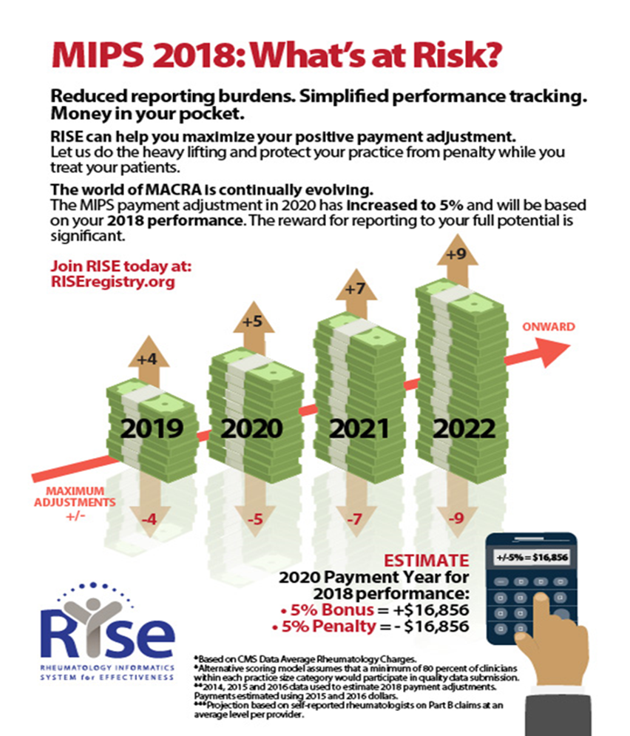
Rheums can use
the ACR RISE
Registry to report
to MIPS!
advocacy@rheumatology.org
Notes:
A MIPS adjustment of 5% could garner a reward or penalty of $16,000 in 2020 based on 2018 performance. 2019 adjustments are higher with up to + or – 7%.
All who submitted through RISE in the first year earned exceptional threshold bonus with access to additional reward money.

Slide 44
The Other Path:
Alternative Payment Models (APMs)
Providers who receive significant revenue from qualifying Alternative Payment Models (APMs) are exempt from MIPS
5% bonus 2019-2024
Qualifying APMs must use certified EMR technology, quality measures similar to MIPS, and be risk-bearing
STAY TUNED for ACR’s new rheumatoid arthritis APM

Slide 45
MACRA: the FIT’s perspective
Is this why we check BMI and smoking status?
Is my institution(s) in MIPS or APM track?
Is my Division using the RISE registry?
Join by summer to ensure onboarding for the year
Familiarity with the 2019 Category Requirements
advocacy@rheumatology.org
Notes:
MACRA influences the practice of rheumatology divisions
For help or further information, email the ACR.

Slide 46
ACR’s Medicare Goals:
Reduce impact of MIPS cost measure
Create an APM track for RA
Reduce barriers to qualifying as an APM
Prevent PBMs from controlling Part B drugs
Prevent cuts to MSK ultrasound

Slide 47
State Update
PBMs and drug prices: a hot topic!
198 bills introduced in 45 states (2019)
43 states have some PBM legislation on the books
29 have banned the “gag clause”
23 have limited “claw-backs”
Biosimilars
48 states have passed biosimilar laws (includes FL)
Most have a 5 day notification requirement
Most allow some variant of “dispense as written”
Step therapy
Virginia, Georgia, and Washington passed step therapy reform in 2019

Slide 48
Agenda
ACR Advocacy overview
Washington Update
What does ACR do for our profession?
YOU Can Make a Difference – today!

Slide 49
Why Advocate?
Exercise your first amendment rights: “petition government for redress of grievances!”
We are in an era of change and tumult. Democracy & institutions require educated input
Extend the “do no harm” ethic to prevent government from harming patients
It’s fun!

Slide 50
How Can I Make A Difference?

Slide 51
How Can I Make A Difference?
Notes:
In LESS THAN 5 MINUTES (before the end of this lecture!)
This list was created by ACR FIT subcommittee

Slide 52
How Can I Make A Difference?

Slide 53
How Can I Make A Difference?

Slide 54
Advocacy 101 for Fellows and PDs
Expense-paid trip to Washington, DC
Learn about US health system and how to advocate
Apply your skills in meetings with elected officials
Bring content home to give Grand Rounds
Surveys: increased knowledge, interest in advocacy and ACR volunteerism
ACGME competency: communication, professionalism, systems-based practice
Goal: every trainee able to attend during fellowship

Slide 55
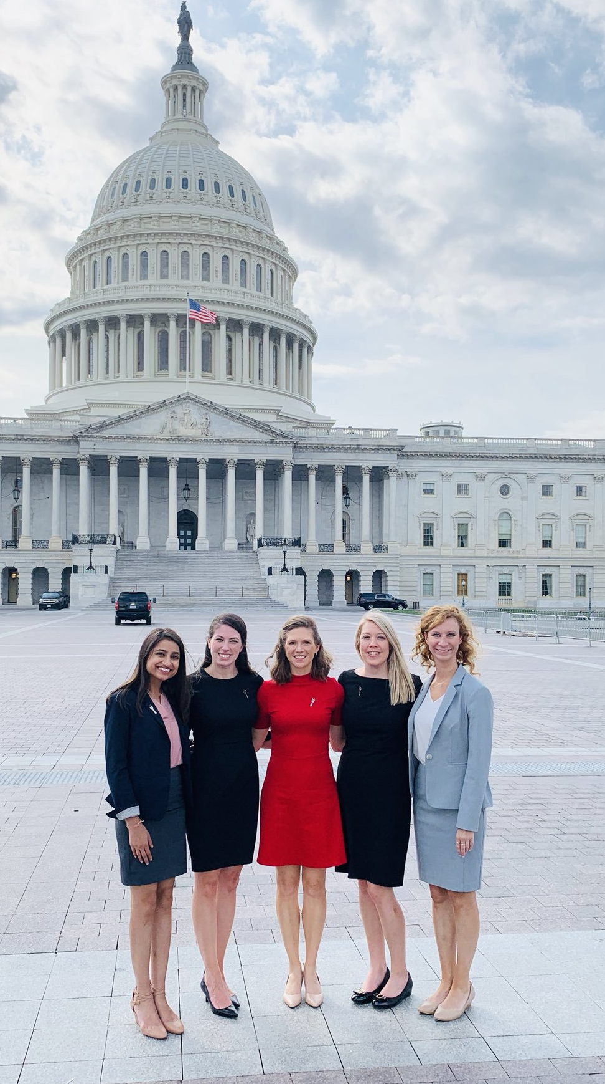
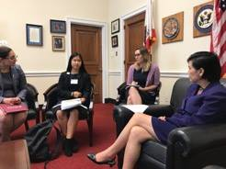
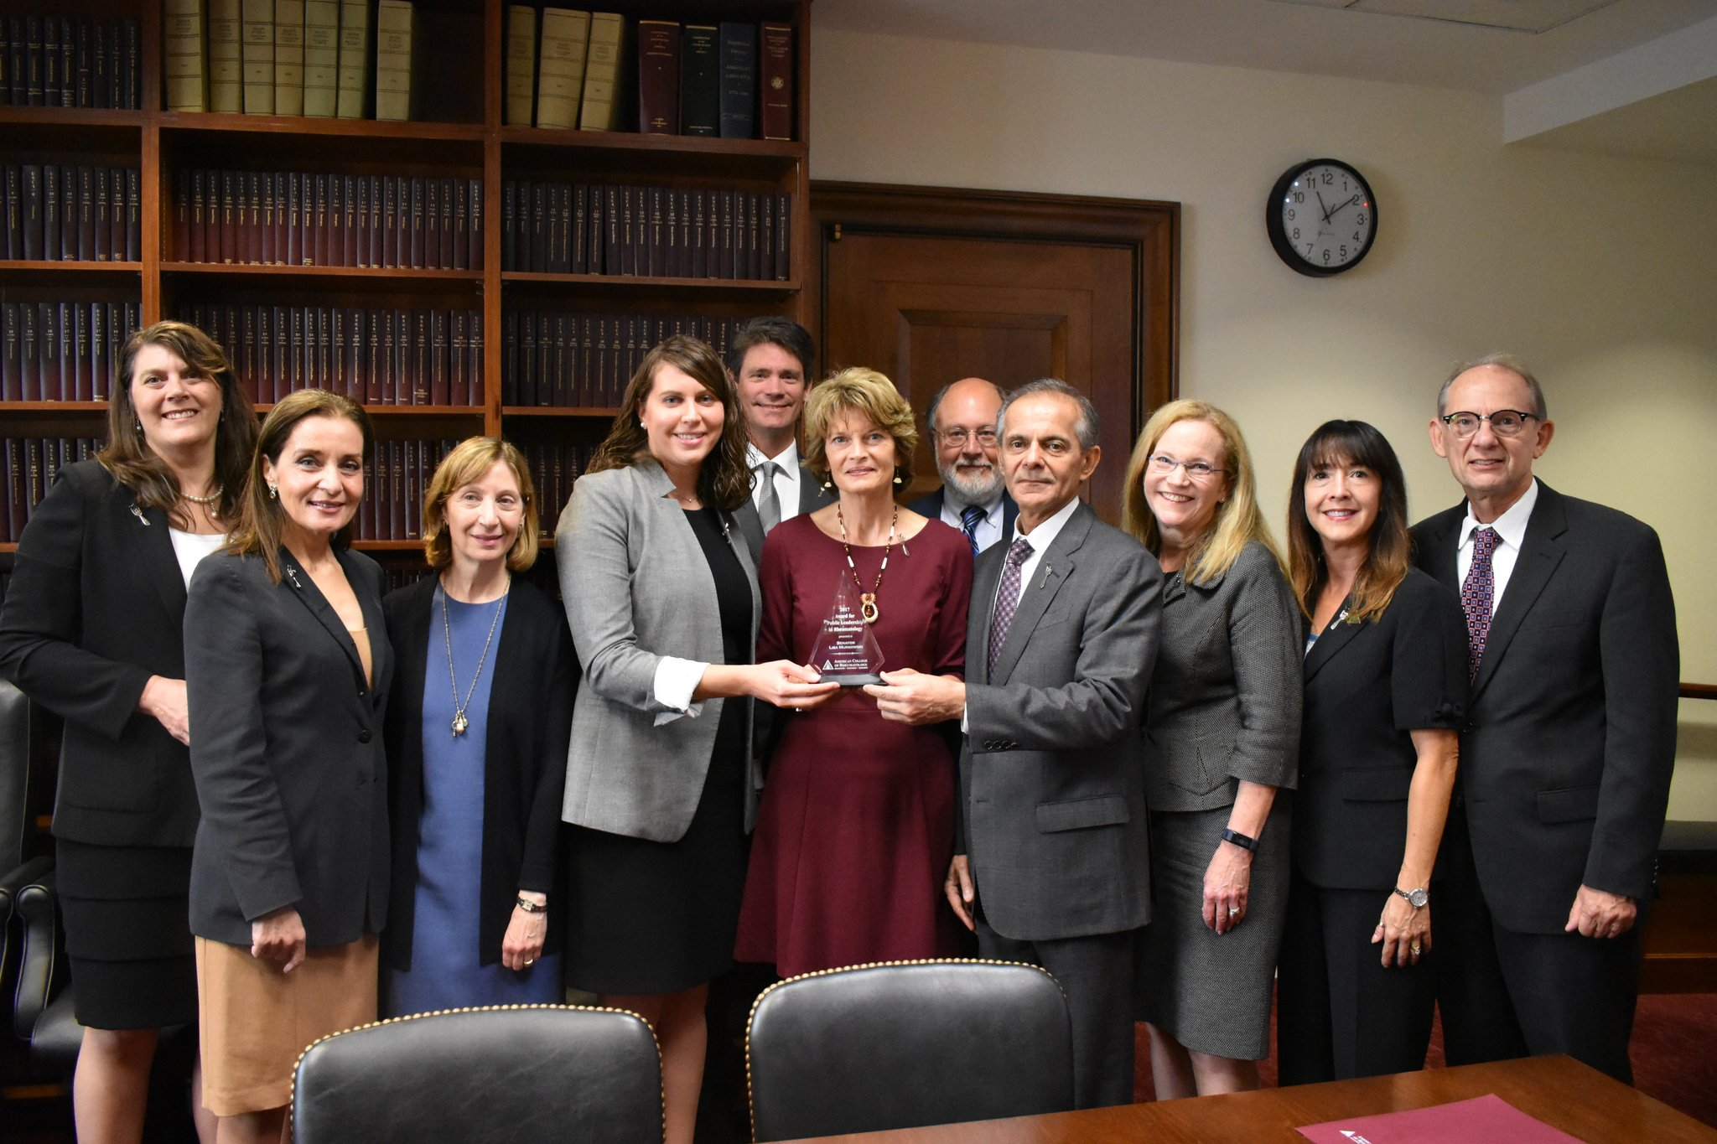
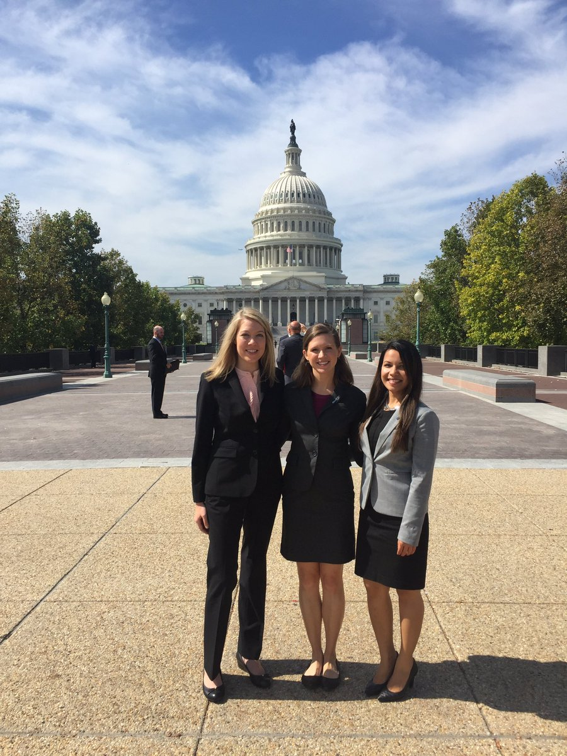
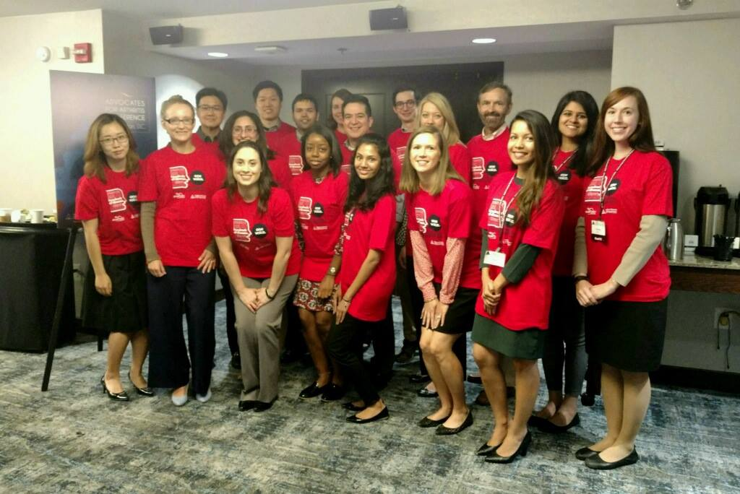
Notes:
Some pics of people having a great time advocating for our profession and our patients on Capitol Hill.
Middle: Dr. Sarah Doaty and Dr. Sharad Lakhanpal give 2017 award for leadership in public service to Sen Lisa Murkowski (AK)

Slide 56
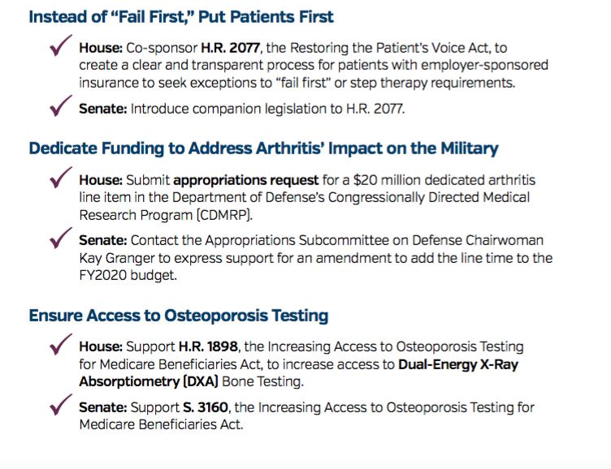
Notes:
Recent advocacy issues included reforming “Fail First” Step Therapy, dedicating funding to rheum research at the Pengaton, and improving reimbursement for DXA.

Slide 57
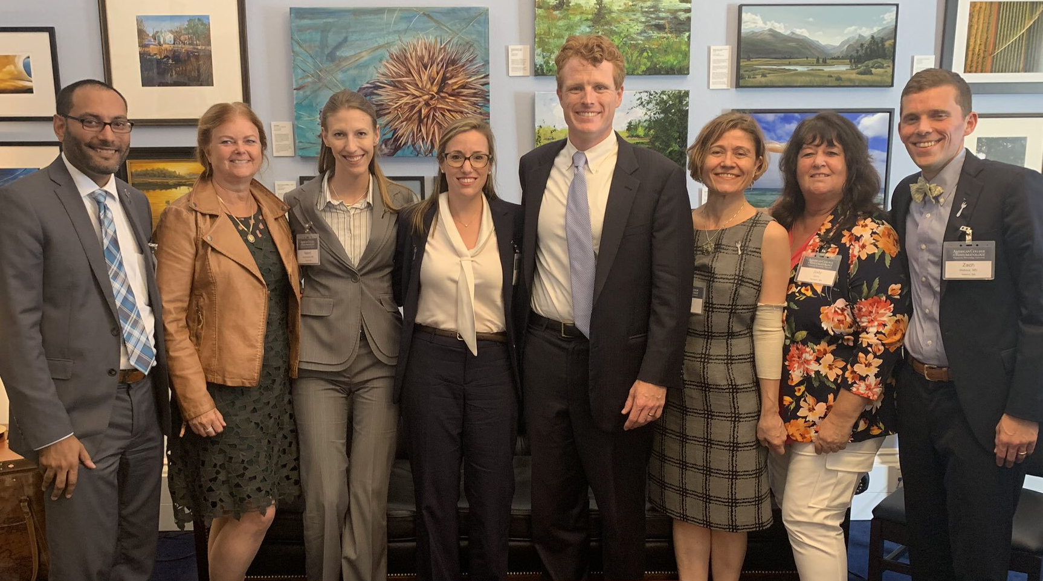
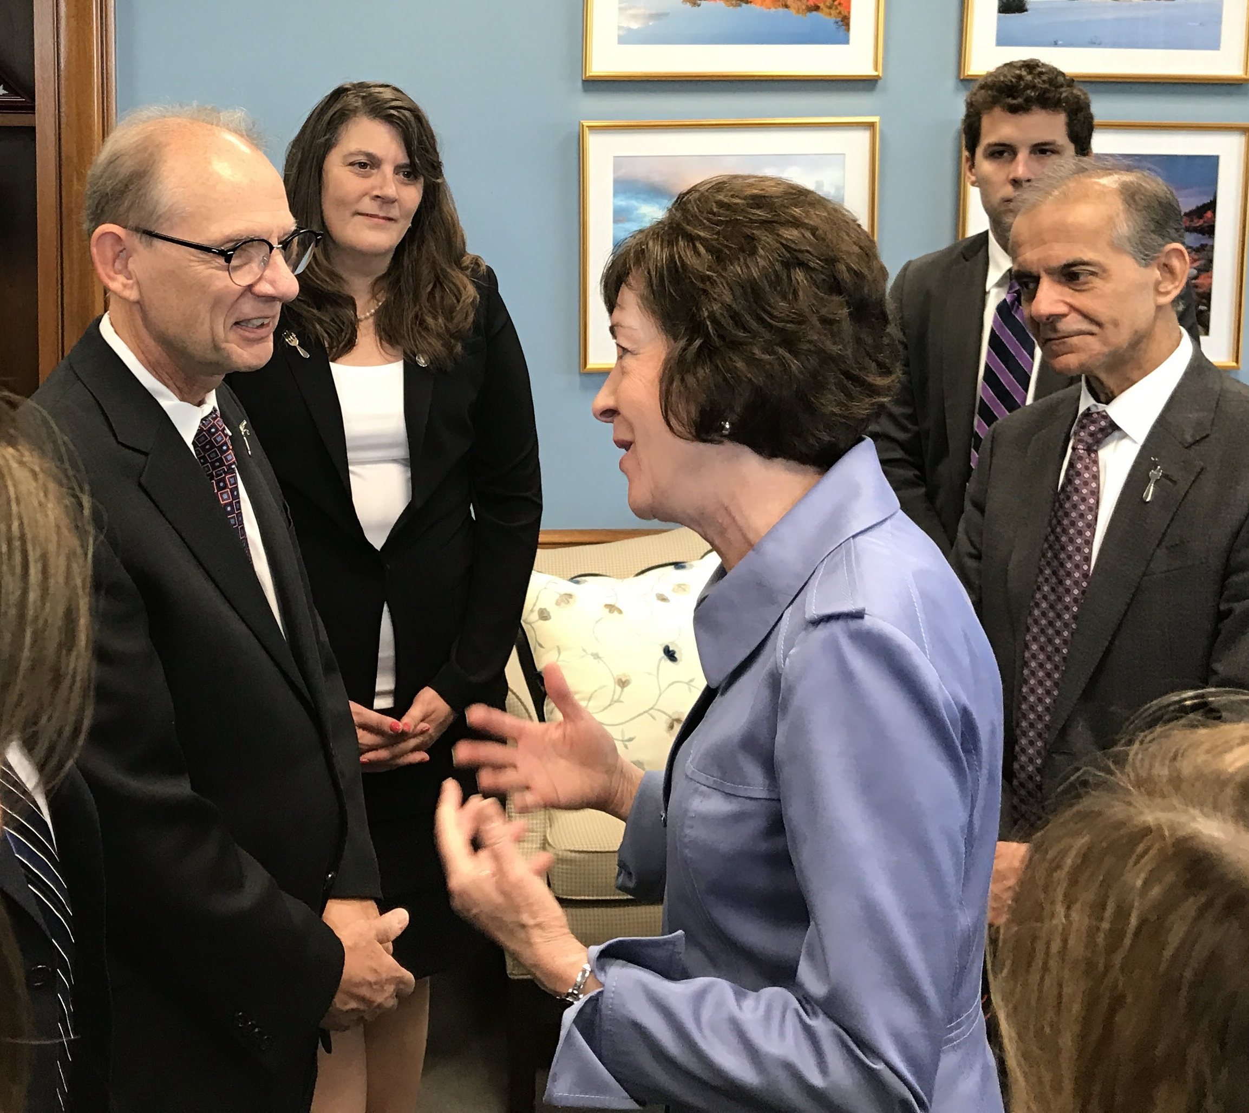
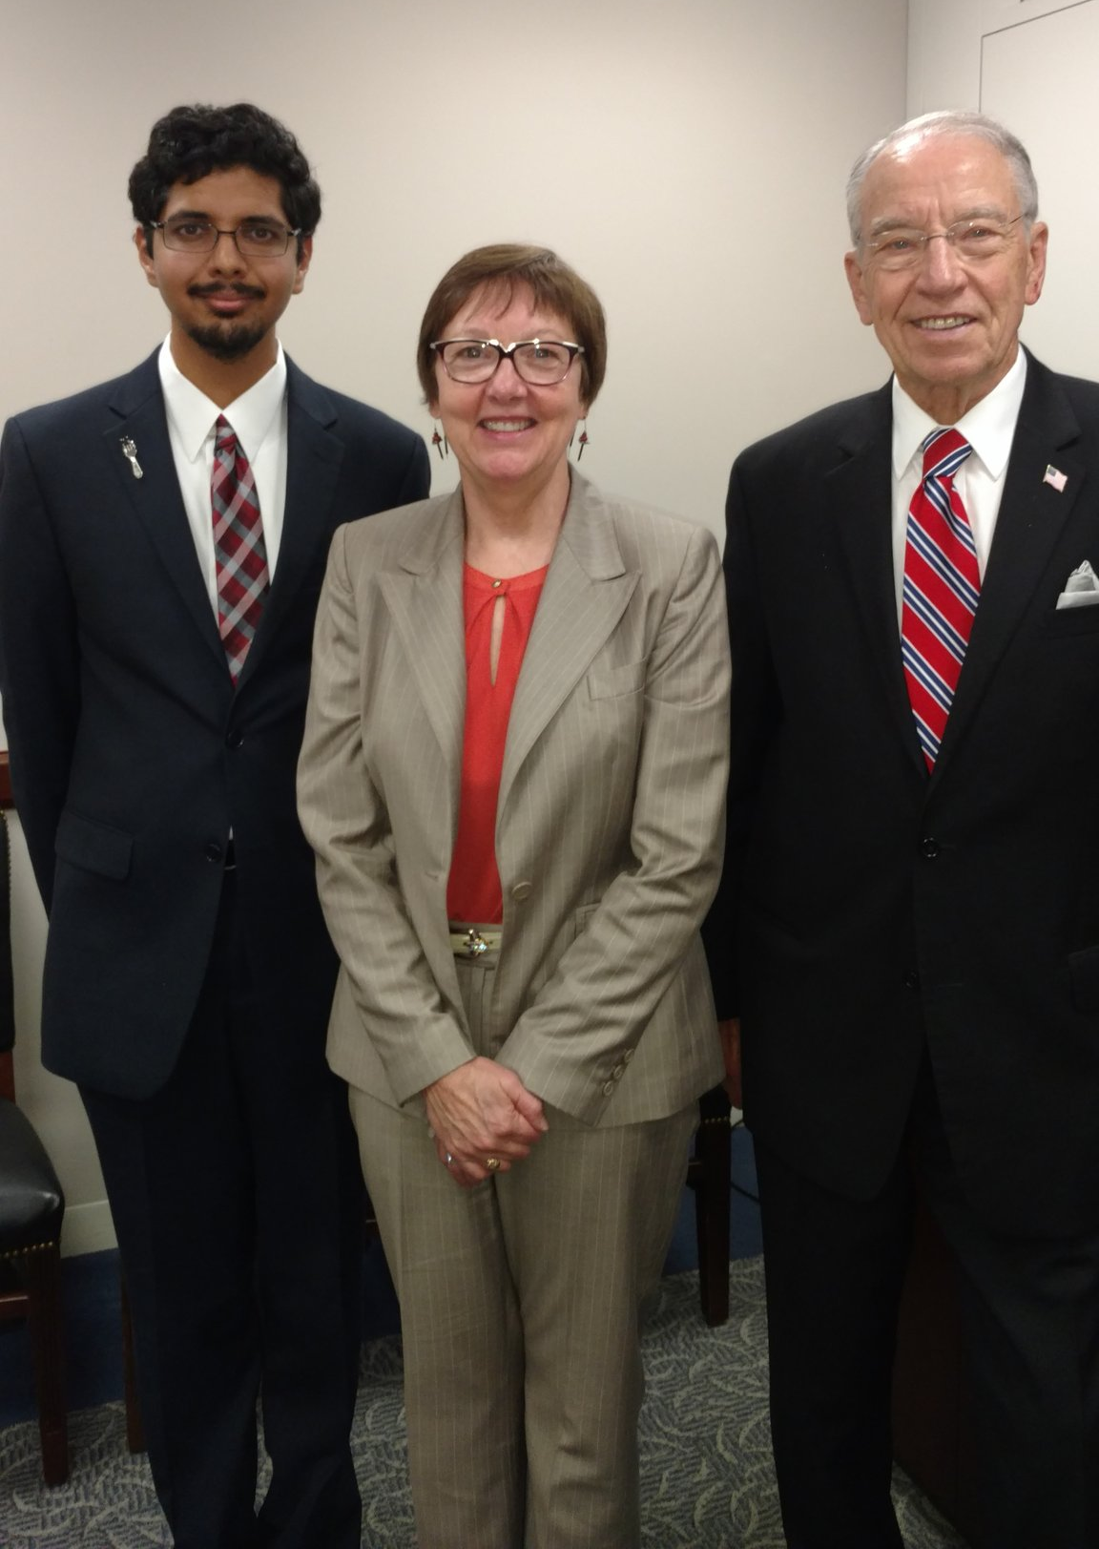
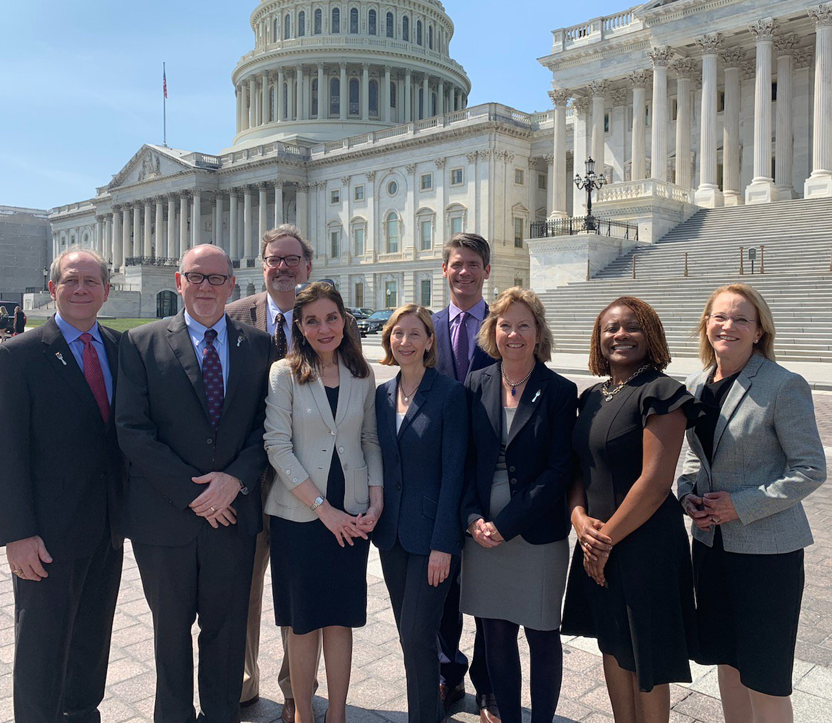
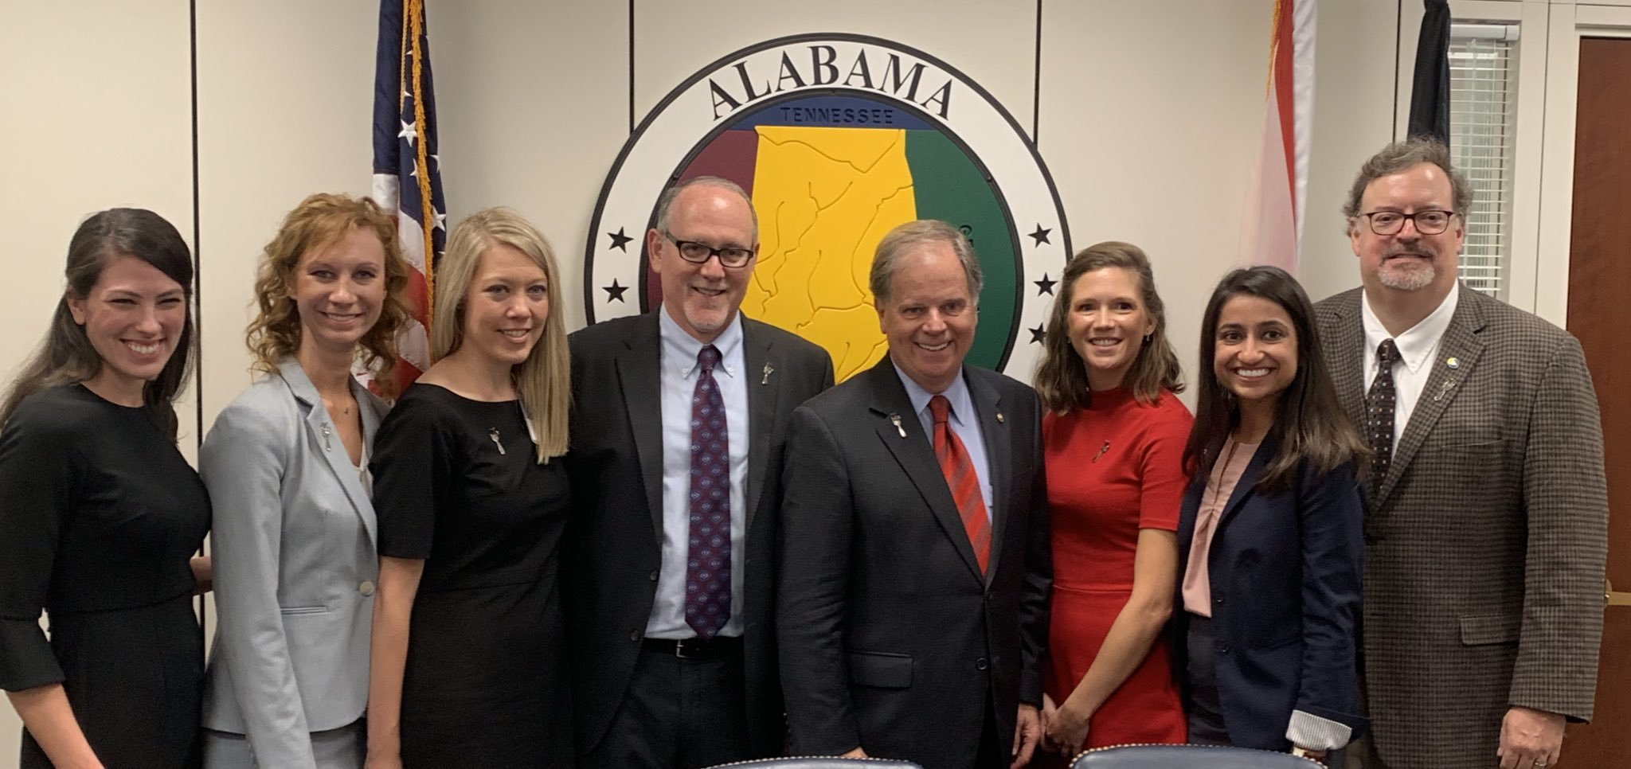
Notes:
Advocates for Arthritis recent years. Rep Kennedy (top left), Sen Collins (top right), Sen Jones (bottom left), ACR Exec Committee

Slide 58
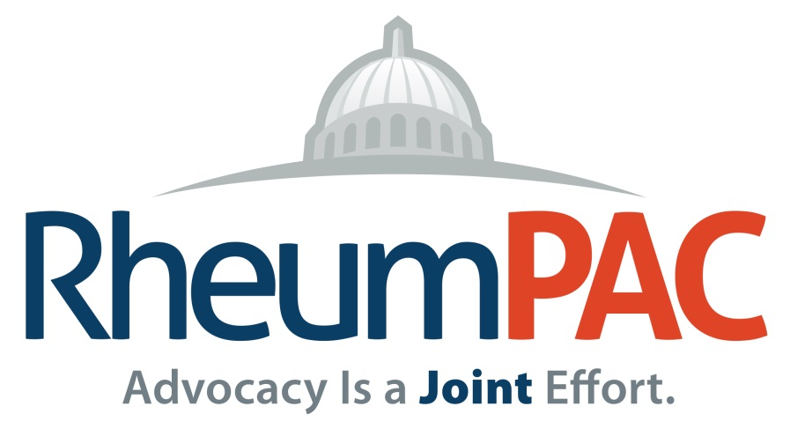
Why is a PAC important
for rheumatology?
Relationship building with 100 new members, leaders, and staff
Seat at the table with key members of Congress
Educate those who will make decisions impacting rheumatology
Help ensure our champions retain their seats in Congress
Notes:
I encourage you to participate in the PAC.
ACR’s strategic plan includes a goal of 10% of ACR members investing in the PAC. Only 3 to 4% have contributed in recent years.

Slide 59
Menu for Making a Difference
Get involved with your state/local Rheumatology society
Join the AMA
Invest in RheumPAC
Use ACR Legislative Action Center to email Congress
Call, write letters, use social media
Invest in Rheumatology Research Foundation (training $)
Come to Capitol Hill! Advocacy 101 with A4A Fly-In –Sept.
Get your patients and friends involved

Slide 60
Discussion
Contact: advocacy@rheumatology.org

